Slide 1
COST OF MEDICATION ERRORS IN PUBLIC HEALTH FACILITIES OF EASTERN REGION, GHANA
Van der Puije et. al, 2019
Presented by:
NII OBODAI MENSAH
ASAMANKESE GOVERNMENT HOSPITAL
EASTERN REGION

Slide 2
OUTLINE
Introduction
Objectives
Materials & Methods
Results & Discussion
Study Limitation
Recommendation
Conclusion

Slide 3
INTRODUCTION 1/4
Medication error is defined as any preventable event that may cause or lead to inappropriate medication use or patient harm, while the medication is in the control of health care professional, patient or consumer. Such events may be related to;
professional practice
health care products
procedures and systems including prescribing, dispensing and administration.
National Coordinating Committee-Medication Error Reporting and Prevention (NCC MERP); accessed at http://www.nccmerp.org/aboutMedErrors.html; June. 2016

Slide 4
INTRODUCTION 2/4
Medication error may be classified according to where they occur in the medication use cycle, i.e. at the stage of;
Prescribing
Dispensing
Administration of a drug

Slide 5
INTRODUCTION 3/4
Approximately two-thirds of all hospital admissions due to medication errors are potentially avoidable (Alexopoulou et al., 2008; Patel et al., 2007; Pirmohamed et al., 2004).
Even though significant progress has been made in the healthcare system, medication error still remains a global challenge and may occur from prescribing, dispensing, and drug administration (Avery et al., 2012; Mahony, 2016; Mekonnen, Alhawassi, McLachlan, & Brien, 2018).

Slide 6
INTRODUCTION 4/4
The economic impact can be direct or indirect.
The economic impact affects the patient, the healthcare provider and the healthcare system.
Patients can be saved the problems of medication errors when interventions such as prescription reviews are regularly conducted.

Slide 7
OBJECTIVES
1. To investigate the incidence of medication errors in acute and chronic disease condition.
2. To evaluate the cost of medication errors to patients and the Health Sytem
3. To ascertain the saved cost of Medication errors to patients and the Health care system

Slide 8
MATERIALS AND METHODS 1/3
Study Design
The study design was a retrospective study.
Study Site:
The study retrospectively reviewed documented interventions made on medication error that had been submitted to the office of the Regional Chief Pharmacist at the Eastern Regional Health Directorate of the Eastern region over a period of 12 months (January 2018 to December, 2018).

Slide 9
MATERIALS AND METHODS 2/3
Sampling and Sample Size Calculation
The study used quota sampling method which is a non-probability method. Quota sampling was used in this study to help ensure that all the facilities that submitted medication error reporting forms are represented.
The selection of the intervention forms were done in such a way that the forms picked represents 10% each of the total number of intervention forms submitted by each facility. This method of selection will give a full representation of all the public health facilities in the region that submitted medication error reporting forms to the office of the Chief Pharmacist.
The 10% of medication error forms from each facility were selected randomly based on the total number of forms submitted by the facility over the review period.

Slide 10
MATERIALS AND METHODS 3/3
Data processing and Analysis
The data collected was entered into a computer using SPSS software version 22.0 and cleaned. It was then analysed using the same software.
The analysed data collected included the under listed;
- Frequency analysis of the characteristics of the medication error intervention forms
Frequency analysis of the medication errors categorized by class of staff committing the error.
- Cross tabulation of the various forms of error by gender
- The categorization of the medication errors against specific disease conditions
- The Cost of prescription errors and the cost saved from the intervention

Slide 11
RESULTS 1/5
Table 1: Summarizes the characteristics of all the study forms
Patient Characteristics | Prescription error forms analysed N (%)
Gender
Female | 100 (66.7)
male | 37 (24.7)
Age group
0 – 9 years | 20 (13.3)
10 – 19 years | 14 (9.3)
20 – 59 years | 71 (47.3)
60+ years | 40 (26.0)

Slide 12
RESULTS 2/5
Table 2: Type and number of diagnosis
Type of diagnosis | Prescription error forms analysed N (%)
Acute | 85 (56.7)
Chronic | 52 (34.7)
Acute and Chronic | 13 (8.6)
Number of diagnosis
1 - 2 | 129 (86)
3 - 4 | 19 (12.7)
5 - 6 | 2 (1.3)

Slide 13
RESULTS 3/5
Table 3. Prescription errors categorized by class/category of
prescribers
Prescription Errors | Physician Assistants | Medical Doctors | Nurses / Nurse prescribers | Others* | Total
Frequency | 93 | 41 | 8 | 8 | 150
Percentage (%) | 62.0 % | 27.3 % | 5.3 % | 5.3 % | 100 %

Slide 14
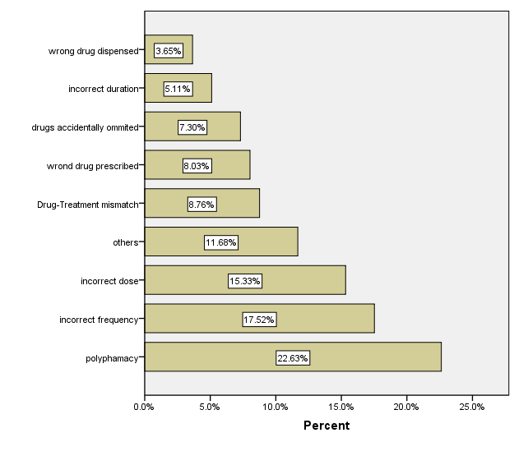
RESULTS 4/5
Fig 1 :Categorization of prescription errors

Slide 15
RESULTS 5/5
Table 4: Cost of prescription errors
DIAGNOSIS | COST OF MEDICATION ERROR (GHC) | COST SAVINGS AFTER INTERVENTION (GHC)
Diabetes | 15,848.56 | 15,454.1
Hypertension | 853.04 | 276.62
Gastro Intestinal Disorders | 212.11 | 132.75
Urinary Tract infections | 415.29 | 231.56
Respiratory Tract Infection | 450.78 | 325.08
*Others | 720.75 | 501.78
TOTAL | 18,500.53 | 16,921.89
*Others include: Septic Arthritis, vagina candidiasis, cellulitis, dermatitis, muscoskeletal pain, furunculosis, pruritis, Retroviral Infection, Lumbago, Insomnia, hyperthyroidism *GHC = Ghana cedis, 1 USD = 5.39 GHC

Slide 16
DISCUSSION 1/6
The study revealed that the majority of the incidence of medication error in public hospitals of the Eastern Region occurred within age group of 20 – 59 years (47.3% ) with 66.7% predominance in females.
The prevalence among the various age groups was contrary to what has been documented in other studies that identified that medication error was more common in the elderly(Bourgeois, Shannon, Valim, & Mandl, 2010; Guthrie et al., 2011).
Over the years available data on hospital attendance has been shown to be dominated by females hence not surprising that they were more affected than their male counterparts.

Slide 17
DISCUSSION 2/6
This study revealed that majority (56.7%) of the medication errors analysed happen in patients with acute episodes which was not similar to what other studies have shown (Bourgeois, Shannon, Valim, & Mandl, 2010; Guthrie et al., 2011)
This could be due to the fact that acute illness feature prominently in the top ten causes of morbidity in our public health facilities
It could also be said that unlike in chronic cases where most of the time is a repetition of the patients previous medication the management of acute illness are not so and require that each time the prescriber has call to memory how these acute illness are to be treated according to the Treatment Guidelines.

Slide 18
DISCUSSION 3/6
This study associated an economic loss of GHS18,500.53 (USD 3,432.38) to medication error in a one-year review of 150 hospital prescription intervention forms(representing 10%) submitted by public health facilities in the Eastern Region of Ghana.
The financial burden of medication errors situation is not peculiar to the Eastern Region of Ghana as the cost of medical errors in the United States is estimated at $19.5 billion in 2008 (Andel et al., 2012)

Slide 19
DISCUSSION 4/6
A saved cost of GHS 16,921.89, (USD 3,139.49) to the health care system in one year was realized from the timely interventions of pharmacists and pharmacy auxiliary staff. A study conducted in the US showed that pharmacists consultation with physicians and others in an intensive care unit (ICU) resulted in a net saving from reduced drug use of $10,011 in a 3-month period (Leape et al., 1999)
In addition, the probability of a patient ending up with an adverse drug event was also avoided in this situation. This is buttressed by studies conducted else where which revealed the rate of medication errors in the Emergency Departments of hospitals decreased significantly when pharmacists prospectively reviewed medication orders (Jamie et al., 2008)

Slide 20
DISCUSSION 5/6
The huge costs of medication errors and cost saved from the reviews were noticed with medicines prescribed for chronic disease conditions such as diabetes and hypertension.
The bothering thought with this situation would be, why should errors be associated with the prescription of routine medications for chronic disease conditions.

Slide 21
DISCUSSION 6/6
This brings to play several factors such as the category of staff prescribing these medications and the prescriber’s therapeutic training in relation to the drug knowledge and experience; knowledge of the patient; perception of patient’s risk and their physical and emotional health as well as the patient’s characteristics and the complexity of the individual clinical case(Slight, S. P.,et al,2013)
This study revealed 62% of physician assistants and 27.3% of medical doctors contributed largely to the identified prescription errors.
Unfortunately, the other compounding factors for the identified medication errors were not ascertained.

Slide 22
STUDY LIMITATION
The study could not assess the cost of medication error to health care providers and patients. This was affected by the absence of data on these fields.

Slide 23
RECOMMENDATIONS
Conduct further studies to explore economic burden of medication errors as a percentage of total health care budget.
Provide continuous health system support and ensure adherence to medicine use guidelines, policies and treatment protocols.
Develop an intervention program to help monitor and appropriately avert economic and clinical burden associated with medication errors at our various health facilities.

Slide 24
CONCLUSION
Medication Error as evidenced by this study and others has proven to be a public health burden that needs attention.
The impact it has on the patient, health care provider and the health care system is worth the reason to make inroads such as scaling up the documentation of medication errors and interventions across the country to give a national picture of its impact and the benefits of the interventions made to save lives and economic losses.
This study demonstrates significant cost savings intervention to medication error and warrants further studies to explore the financial contribution of medication errors to health care budget in Ghana.

Slide 25
Acknowledgment
Regional Director of Health Services, Eastern Region
Head of Pharmacy, ERH
Hospital Pharmacy Managers, Eastern Region
Health information Unit, ERHD

Slide 26
THANK YOU

